Slide 1



The Extended YANG Data Model for DOTS Used in DDoS Mitigation
Linzhe Li $‡$, Xiaohui Xie$†$, Yong Cui $†$
$†$Tsinghua University, $‡$Zhongguancun Laboratory
lilz@zgclab.edu.cn

Slide 2
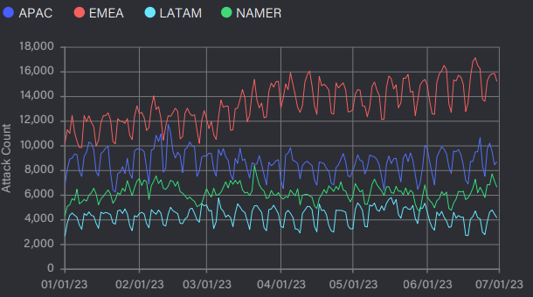
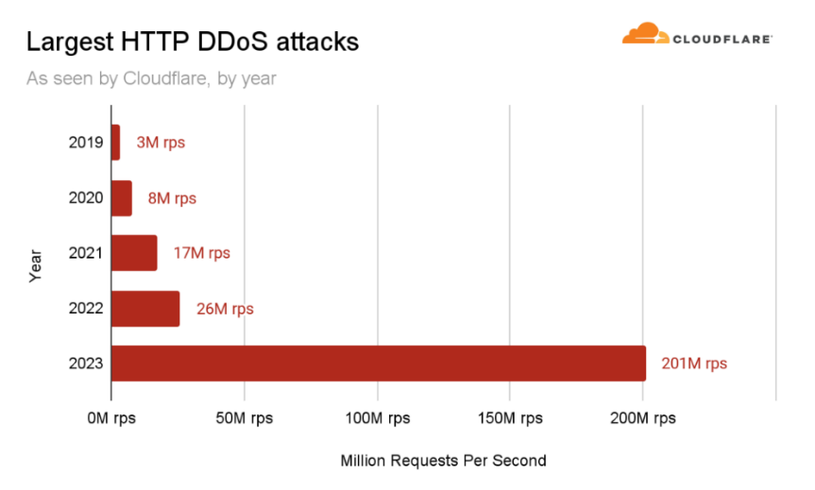
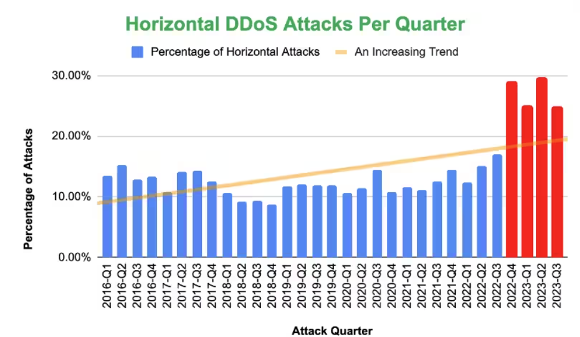
DDoS attack trends
The constantly evolving Distributed Denial of Service(DDoS) attacks pose a significant threat to the cyber world
More frequent, Hyper-volumetric, More Intelligent
Notes:
第二段比较长，格式统一调整一下

Slide 3
Challenges of DDoS Mitigation
Slow and inaccurate attack detection
It usually takes more than 1 minute for ISP to detect an attack.（DFI）
New means of attack(e.g. carpet-bombing attacks) are difficult to detect.
Limited resources
Most defense systems are not capable of defending against terabyte attacks.
High defense cost
Long-term purchase and operation of large-scale defense resources against random DDoS attacks.

Slide 4
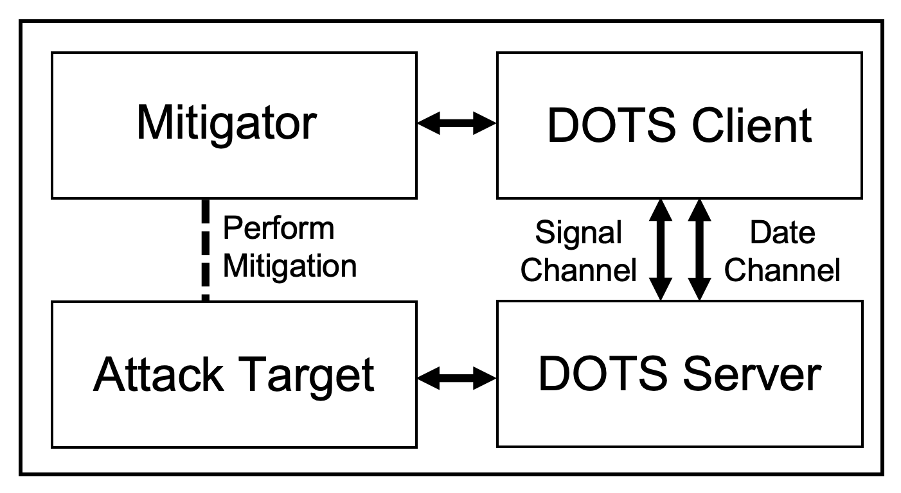
Collaborative Mitigation is Needed!
DDoS Open Threat Signaling (DOTS) protocol is used for coordinated response to DDoS attacks
Between any device or software product involved in DDoS mitigation
Collaborative information includes collaborative mitigation requests, monitoring data, etc

Slide 5
Collaborative Mitigation is Needed!
However, DOTS protocol no longer meets the requirements for some collaborative mitigation needs due to
Limited pre-configuration information
Mitigation requests lack attack characteristics
The lack of detailed mitigation requirements …

Slide 6
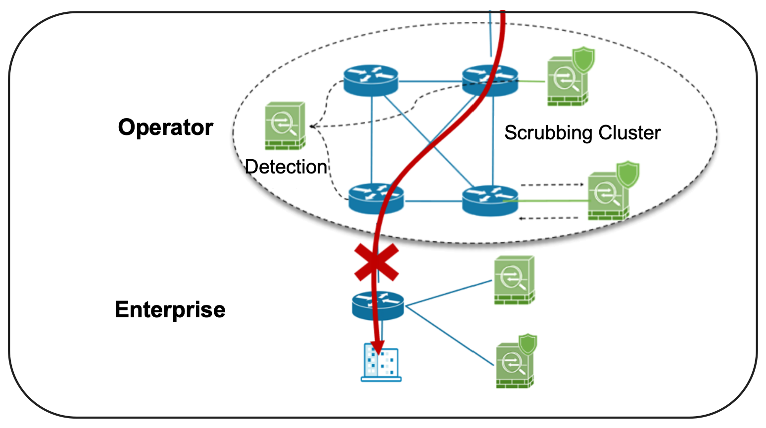
An Example Scenario
The scale of transient flooding attack traffic exceeds enterprise bandwidth, requiring collaborative mitigation
Operators match minute-level attack alarms with mitigation requests (Only target IP and protocol info) to formulate collaborative mitigation policies
Minute-level collaborative response still lead to enterprise breakdown

Slide 7
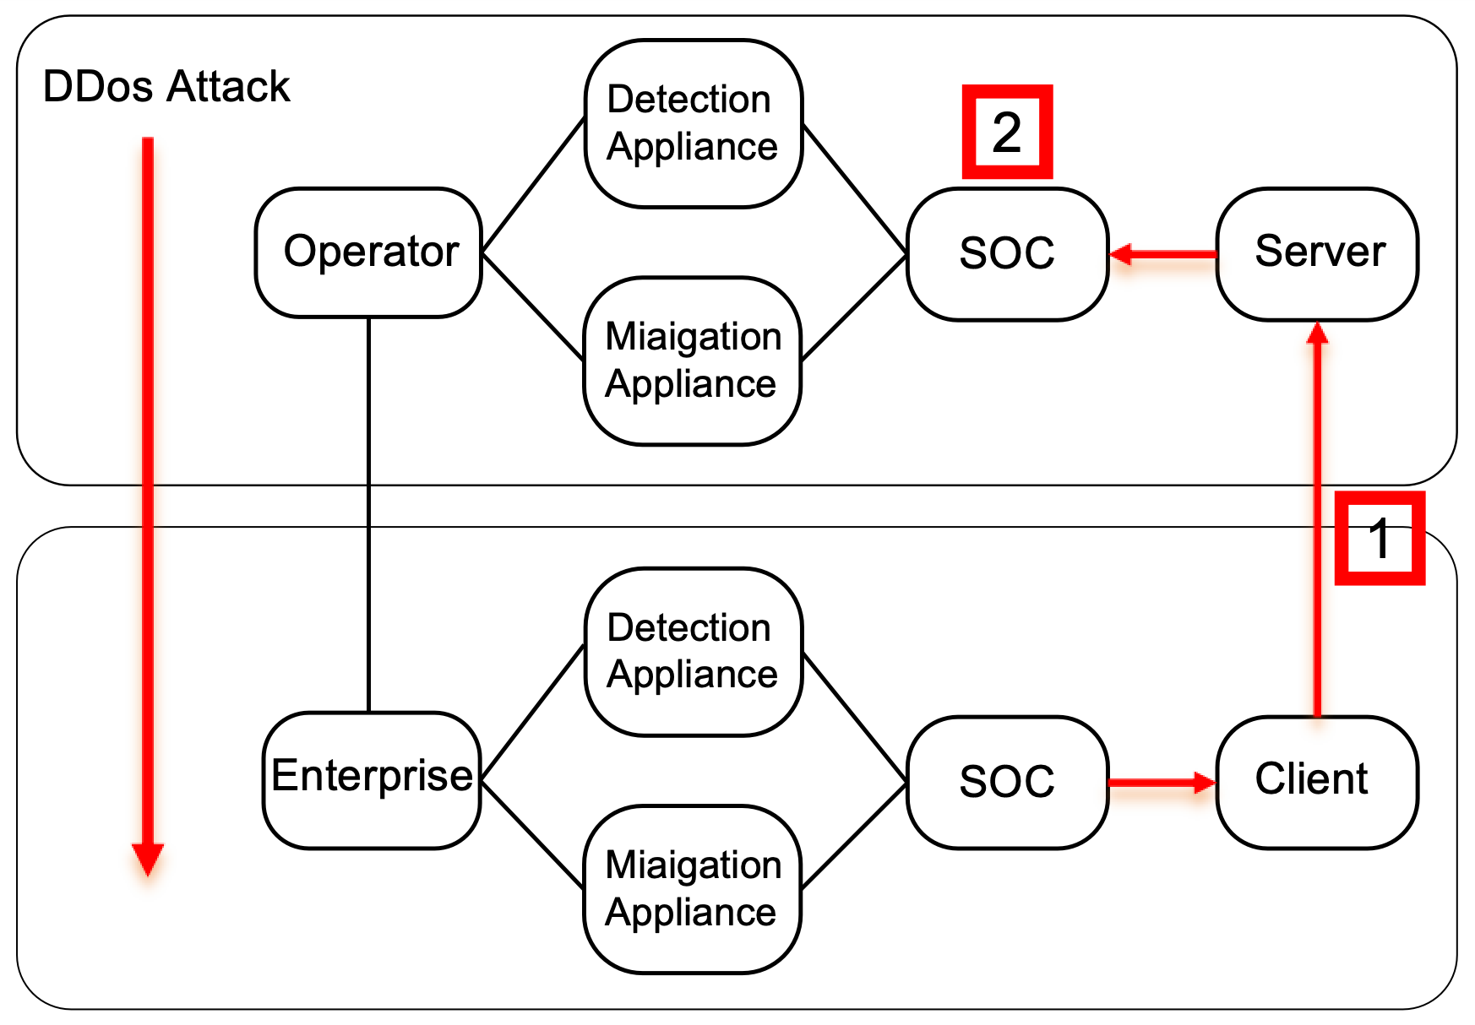
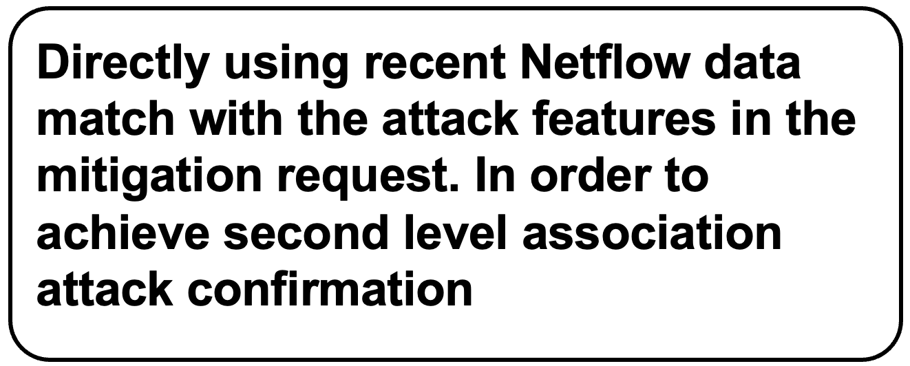
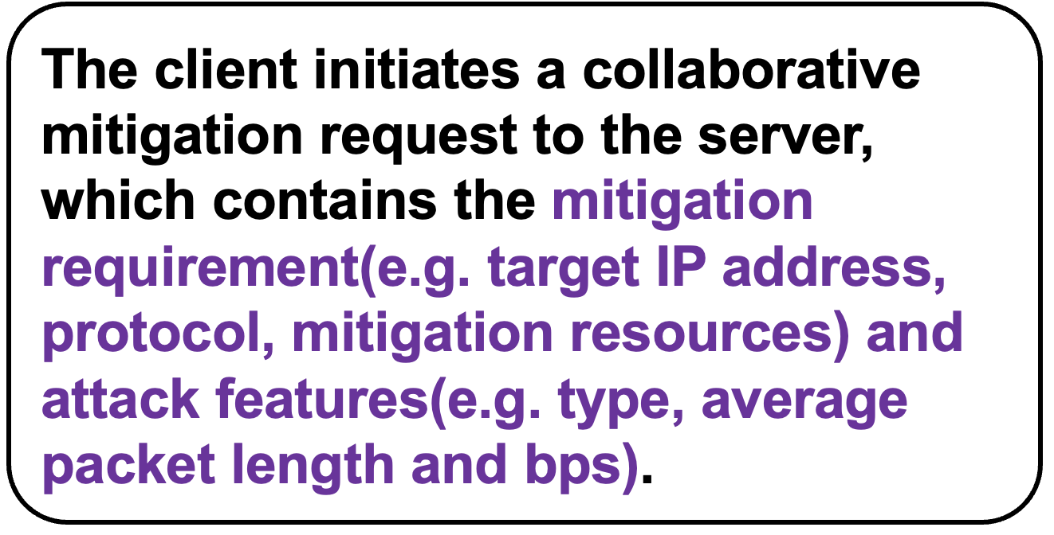
Extended YANG Data Model for DOTS

Slide 8
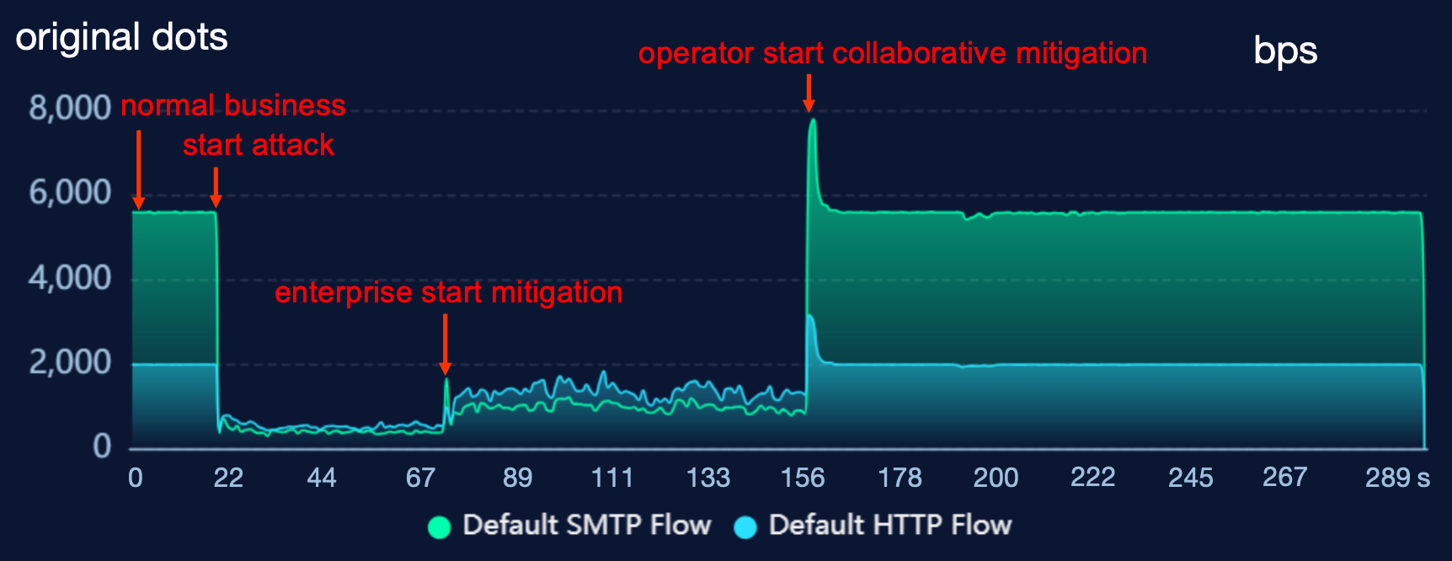
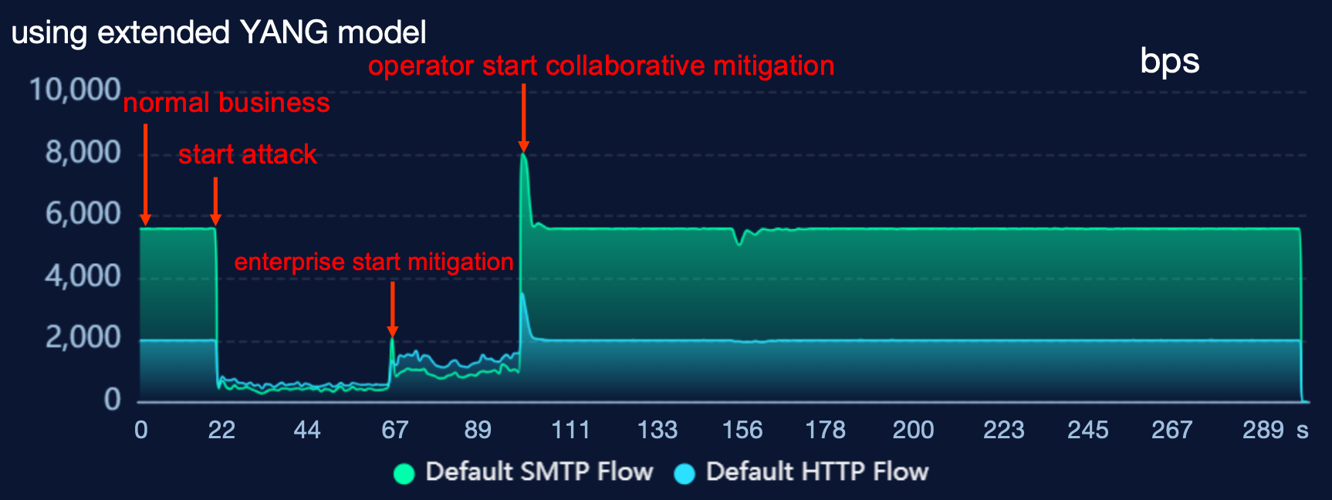
Validation Results
We implement the extended data model in a testbed
With the extended collaborative mitigation model, operators started mitigation 43% faster!
By inference, in the network, the mitigation time can be reduced from minute level to second level.

Slide 9
Thanks!
For more details Please see draft-cui-dots-extended-yang-01

